Slide 1
Arduino Nano Bootloader Update
www.binaria.co.uk
How to… and why you might want/need to!
ILN 2022

Slide 2
What is the Bootloader?
www.binaria.co.uk
It is a small piece of code that runs when the Nano is powered up or reset.
It checks to see if a new sketch is being sent, else it runs the existing sketch in flash memory.
ILN 2022

Slide 3
Why Update the Nano Bootloader?
www.binaria.co.uk
The “old” bootloader has a bug that prevents the Watchdog Timer from working properly.
The “old” bootloader is bigger than the new one, so after updating, more flash memory (1.5KB) can be available for sketches. *
The new bootloader allows faster uploads as it uses 115200 baud – the “old” bootloader uses 57600 baud.
    * If you also fix the high fuses.
ILN 2022

Slide 4
How to Update the Nano Bootloader
www.binaria.co.uk
Verify the Nano has the “old” bootloader.
Set up an Arduino Uno as “Arduino as ISP”.
Why use an Uno as the programmer?
- It has the newer bootloader with 115200 baud.
- It is not a Nano, so the programmer and the programmed are obvious.
Connect the Uno to the Nano – just 6 wires needed.
Adjust the Nano high fuses (in “boards.txt”).
Restart the IDE and burn the new Nano bootloader.
Verify the Nano bootloader update.
ILN 2022

Slide 5
Illustrating the Nano WDT Issue
www.binaria.co.uk
Specifically written sketch that triggers the watchdog timer and resets the Arduino.
The WDT test works as expected on an Uno.
It does not work on a Nano with the “old” bootloader.
And, the Nano must be re-powered to recover!
The sketch has a hardware option to disable the WDT test.
- Connect pin 2 to GND to disable the WDT test.
ILN 2022

Slide 6
An Uno as “Arduino as ISP”
www.binaria.co.uk
Connect the Uno to the PC.
Set the Uno as the IDE target board.
Select to correct serial port.
Upload the “ArduinoISP” example sketch.
Monitoring the Uno ISP activity (optional):
- Uno pin D7 – Programming: LED to a 330Ω resistor to GND.
- Uno pin D8 – Error: LED to a 330Ω resistor to GND.
- Uno pin D9 – Heartbeat: LED to a 330Ω resistor to GND.
ILN 2022

Slide 7
Connect the Uno to the Nano
www.binaria.co.uk
Uno pin D10 → Orange wire to Nano ICSP pin 5 (RST).
Uno pin D11 → Yellow wire to Nano ICSP pin 4 (MOSI).
Uno pin D12 → Green wire to Nano ICSP pin 1 (MISO).
Uno pin D13 → Blue wire to Nano ICSP pin 3 (SCK).
Uno +5V → Red wire to Nano ICSP pin 2 (+5V).
Uno GND → Brown wire to Nano ICSP pin 6 (GND).
(! this is how my Uno and Nano are connected !)
ILN 2022

Slide 8
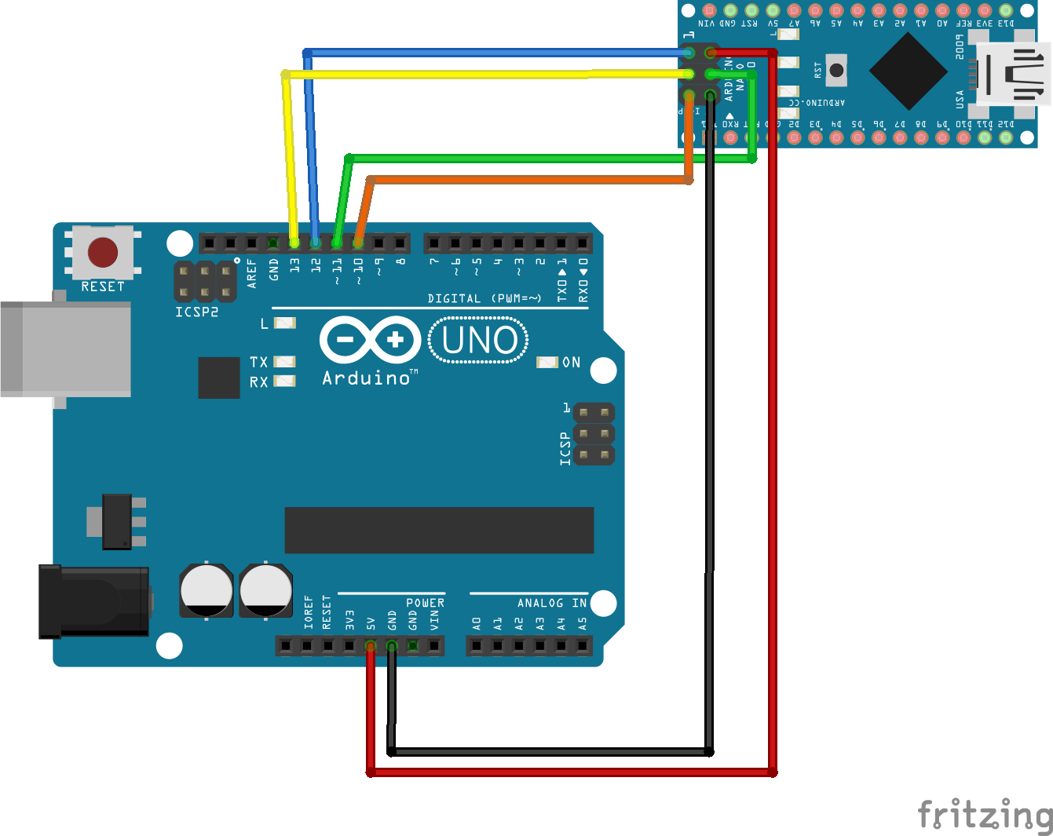
Connecting the Uno to the Nano
www.binaria.co.uk
Nano Uno
ICSP #1 MISO D12
ICSP #2 +5V +5V
ICSP #3 SCK D13
ICSP #4 MOSI D11
ICSP #5 RST D10
ICSP #6 GND GND
ILN 2022

Slide 9
Adjust the Nano High Fuses
www.binaria.co.uk
Backup the “boards.txt” file!
In “boards.txt”, fix some “not old” Nano entries:
- Max flash size, 30720 → 32256
(nano.menu.cpu.atmega328.upload.maximum_size=32256)
- High Fuses, 0xDA → 0xDE
  (nano.menu.cpu.atmega328.bootloader.high_fuses=0xDE)
- Copy the equivalent numbers from the Uno entry!
Restart the Arduino IDE for it to see the updates!
ILN 2022

Slide 10
Burning the New Nano Bootloader
www.binaria.co.uk
Turn on verbose output during upload.
Select the programmer “Arduino as ISP”.
Set the Nano as the IDE target board.
Set the processor to “ATmega328P”.
Check the Uno serial port is still selected.
Burn the bootloader.
Change the programmer back to “AVRISP MkII”.
ILN 2022

Slide 11
Has the Update Worked?
www.binaria.co.uk
Lets retry the WDT test script on a Nano.
Set up the IDE board, processor and serial port.
Upload the WDT test script again.
- Flash memory is cleared during the bootloader update!
- Does the Nano now connect at 115200?
- Is there more flash memory available for sketches?
Finally...
Is the WDT test script working correctly on the Nano?
ILN 2022

Slide 12
Hurrah! Success!
www.binaria.co.uk
But please remember:
All information was accurate at the time of recording.
It worked for me, but everything is at your own risk!
Good luck
ILN 2022

